Slide 1
Censorship and Information Control
Nick Feamster Princeton University

Slide 2
Control of Online Communication
Controlling Protocols Filtering and manipulation of Internet protocols
HTTP, TCP/IP, DNS
Circumvention tools (e.g., Tor)
Controlling Attention Filtering and manipulation on Internet platforms
Filter bubbles
Personalization (and attacks)
Automated filtering

Slide 3
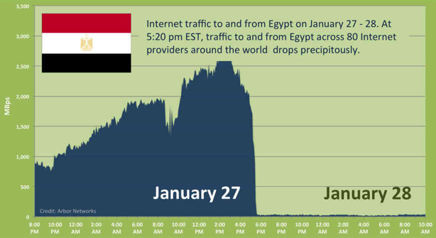
Notes:
2011

Slide 4



Controlling Protocols: Internet “Kill Switch” / Filtering
Censor
Censor
Firewall
Alice
Block Traffic
Bob
Censored net
Uncensored net
Punish User
Notes:
“Ok so now I’m going to give you a brief primer on Internet censorship and some existing approaches taken to overcome it.”
“Suppose Alice wants to get some content from Bob. If she accesses the Internet from behind a censorship firewall then the censor may monitor or block communication with Bob, and may even punish Alice for trying to communicate with Bob.”

Slide 5
Might We Ever Have an Internet “Kill Switch?

Slide 6
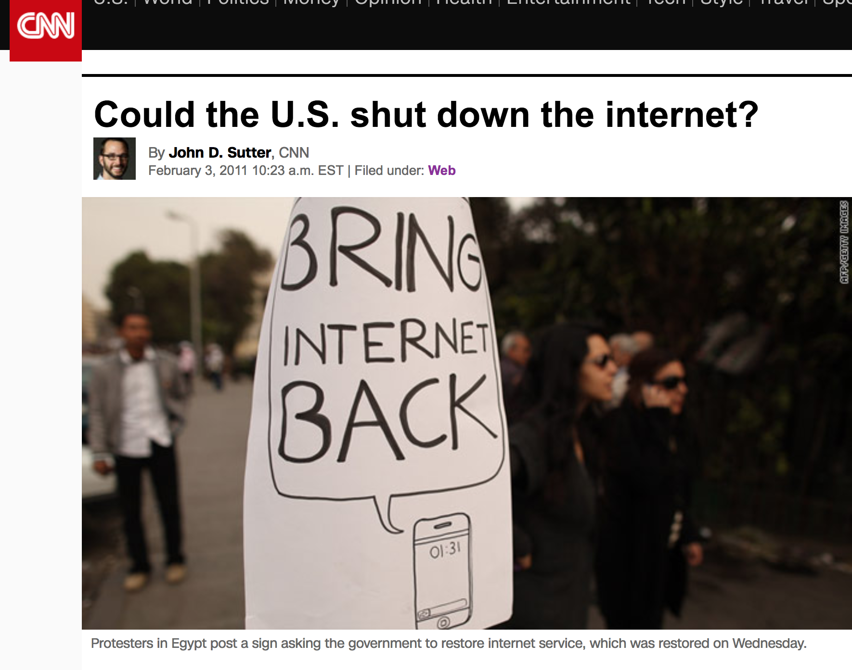

Slide 7
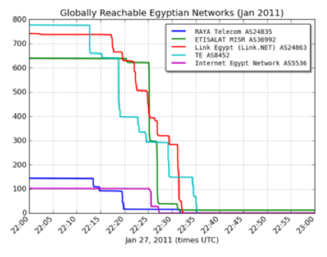
The Internet “Kill Switch”: Take 1
Source: Renesys

Slide 8
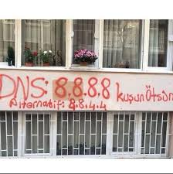
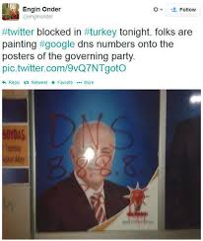
The Internet “Kill Switch”: Take 2

Slide 9
Questions About Protocol Control
How widespread is Internet censorship?
How variable is it, in space and time?
How do countries implement censorship?
What are the trends in censorship and (more broadly) information manupulation?
What can citizens and users do about it?

Slide 10
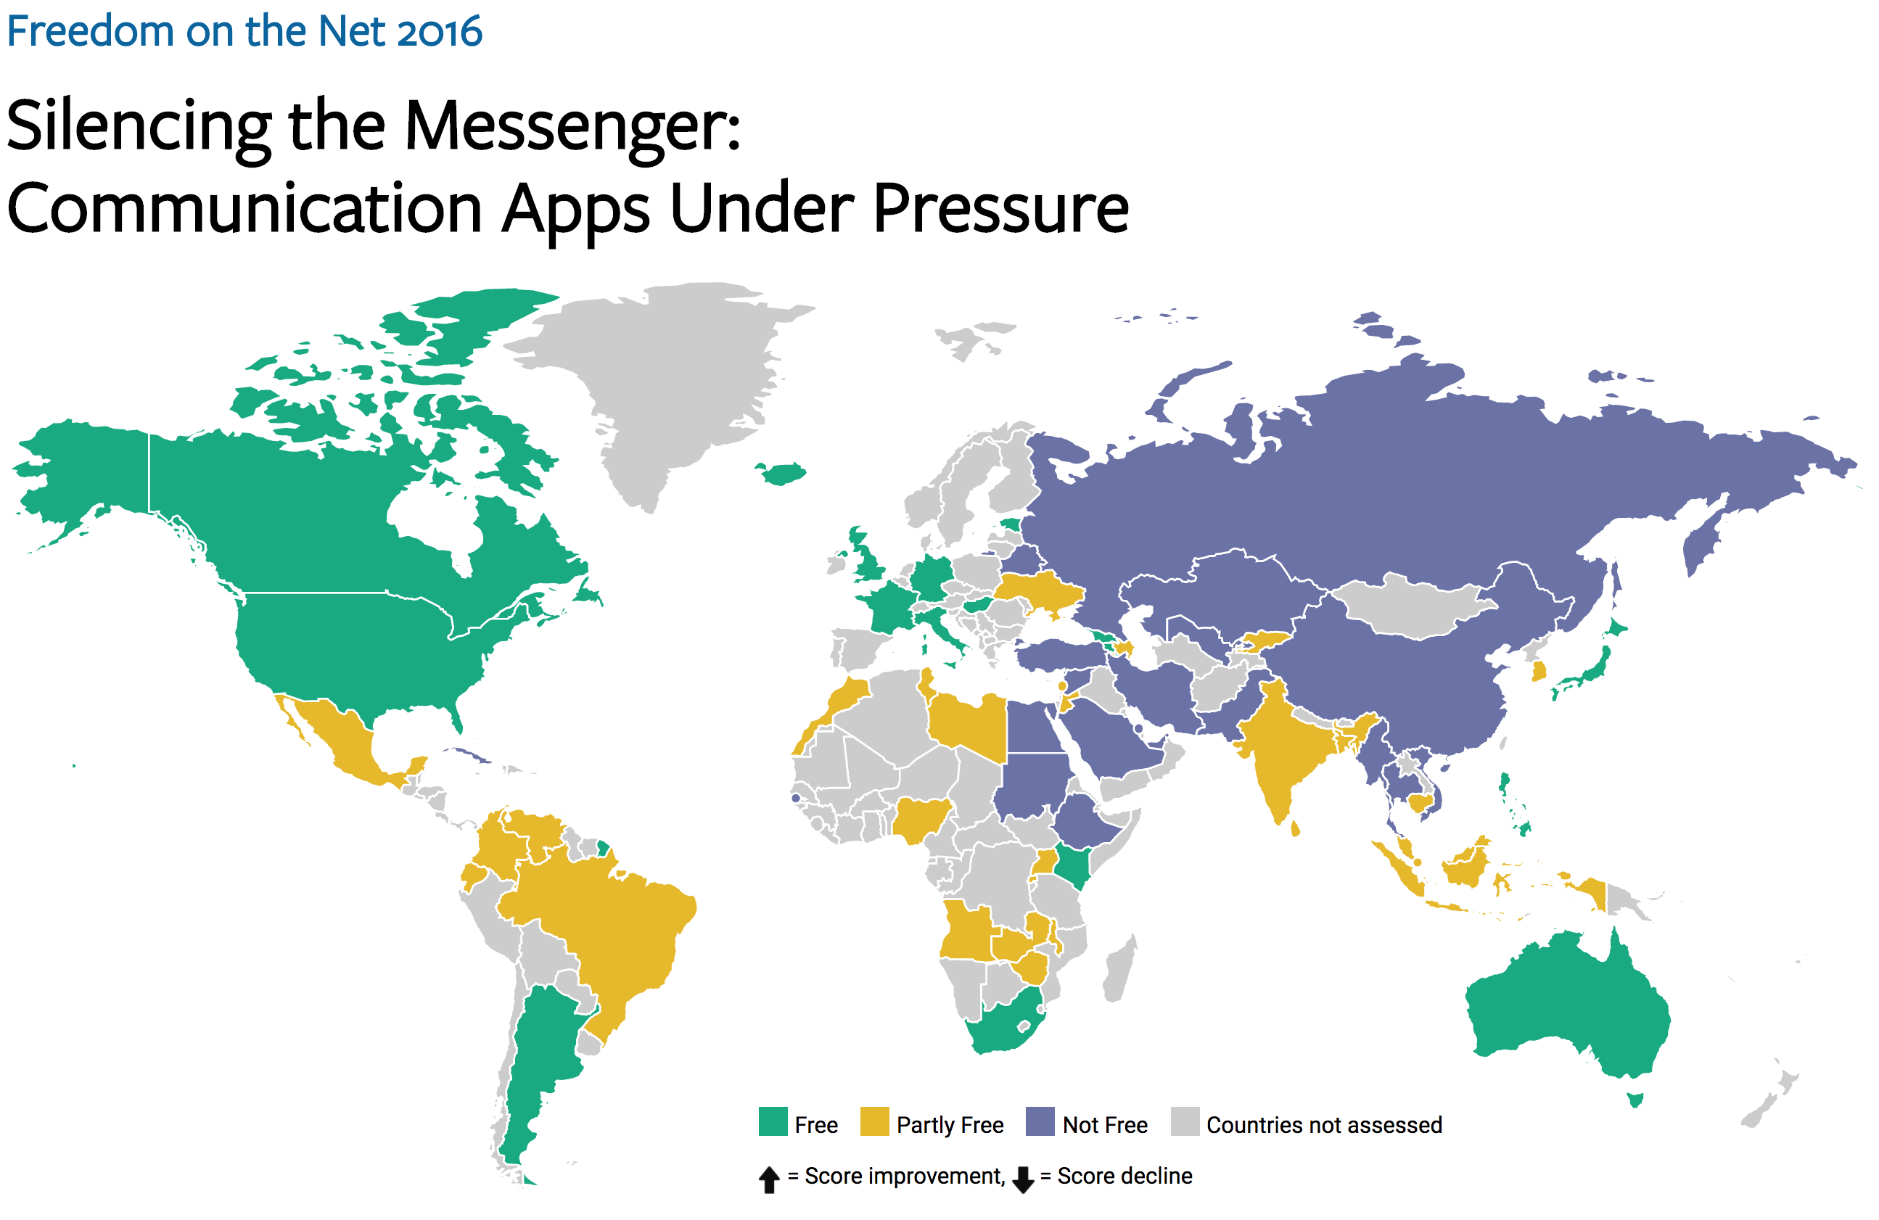

Slide 11
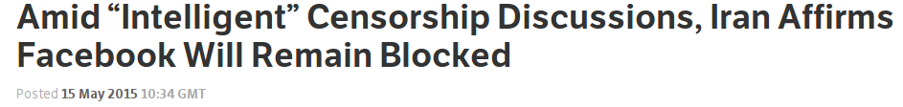
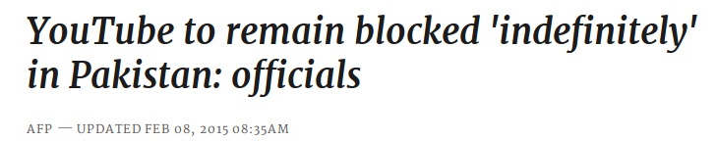
Knowledge of censorship often
begins and ends with anecdotes
Notes:
Examples of Web censorship across the globe continuously pop up in the news, as recently as a week ago. Unfortunately, our knowledge of these events both begins and ends with anecdotes.

Slide 12


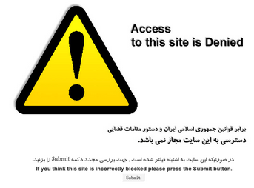
Wanted: More than Anecdotes…
What is censored?
Where is it censored?
When is it censored?
How is it censored?
Iran
2009
Notes:
We’d like to move beyond that. For any instance of censorship, researchers hope to learn four things: What is censored, Where it’s censored, When it was censored, and How it’s being censored. For example, in one persistent example, YouTube has been blocked in Pakistan since September of 2012. It’s often enforced via DNS injection to show users a block page like this one.

Slide 13
Moving Beyond Anecdotes is Hard
Many locations, languages, and cultures
Recruiting lots of vantage points is necessary but hard
Many censorship mechanisms
Measurements must be flexible
A big challenge is diversity

Slide 14





Censorship Measurement Today
Anecdote
(Twitter censored in Iran)
Researcher
Custom measurement software
Vantage points
Censor
Web service
Notes:
The biggest drawback is scale
Still effectively anecdotes
Political and social scientists want more data
The Citizen Lab, Berkman Center, Princeton, etc.

Slide 15

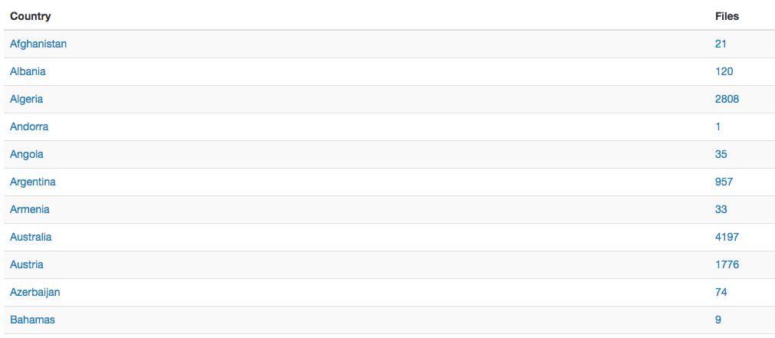
State of the Art: OONI

Slide 16

Encore: Measure Using Web Browsers
Anecdote
(Twitter censored in Iran)
Custom software
Researcher
Every Web browser is a potential vantage point
Instrumented
Web page
<iframe
src="//encoreenco.re/task.html"
width="0" height="0"
style="display: none">
</iframe>
Volunteer Web site
Vantage points
Censor
Web service

Slide 17
How Encore Works
Origin Web site
GET /
Vantage point
“Can you access http://twitter.com?”
http://encoreenco.re
Web browser
in Iran
Cross-origin
GET /favicon.ico
Measurement target
How?
Censor
http://twitter.com
Burnett, Sam, and Nick Feamster. "Encore: Lightweight measurement of web censorship with cross-origin requests." ACM SIGCOMM. 2015

Slide 18
Same-Origin Policy
An origin is a tuple: (protocol, hostname, port)
https://twitter.com → (https, twitter.com, 443)
Browsers prevent cross-origin data reads:
AJAX requests
Inspection of iframe contents
Cookies and local storage

Slide 19
Encore Doesn’t Need to Read Data
It only needs to know whether a URL loaded.
Restrictions on resource embedding are looser.
Examples:
Images with <img>
Style sheets with <style>
Arbitrary content with <iframe>

Slide 20

Ways to Censor Twitter
Domains
NXDOMAIN
Drop request
Inject response
Q: twitter.com?
R: 185.45.5.43
DNS
resolver
IP addresses
TCP SYN
Censor
Send RST
Drop SYN
User
TCP SYN-ACK
HTTP GET /
URLs
HTTP 200 OK
Send RST
Drop GET
HTTP 302
twitter.com
Web server

Slide 21
Inferring Censorship
Domains
NXDOMAIN
Drop request
Inject response
Many images, same domain
Q: twitter.com?
R: 185.45.5.43
DNS
resolver
IP addresses
TCP SYN
Many images, same IP
Send RST
Drop SYN
User
TCP SYN-ACK
HTTP GET /
URLs
HTTP 200 OK
Send RST
Drop GET
HTTP 302
Load URLs in iframe
twitter.com
Web server

Slide 22
Ethics (another full lecture…)

Slide 23
Can We Reduce Encore’s Risks?
Risk depends on usage
What URLs we ask users to measure
Which users run those measurements
Low-risk use cases
URLs often loaded with cross-origin requests
Scalable network availability monitoring

Slide 24
Encore: Summary
Encore enables measurement of Web censorship using ordinary Web browsers as vantage points.
A technique for measuring censorship at scale
A censorship emulation testbed
Open source software
https://github.com/noise-lab/encore

Slide 25
Control of Online Communication
Controlling Protocols Filtering and manipulation of Internet protocols
HTTP, TCP/IP, DNS
Circumvention tools (e.g., Tor)
Controlling Attention Filtering and manipulation on Internet platforms
Filter bubbles
Personalization (and attacks)
Automated filtering

Slide 26



TCP/IP
TCP Handshake:
SYN-ACK
RST
SYN [IP ID:X]
Port status is open/closed
SYN/ACK [IP ID: Y]
ACK [IP ID:X+1]
SYN
SYN/ACK
SYN/ACK
SYN/ACK
Port status is open
Notes:
First some backgrounds:
Remember the TCP uses a three way handshake. Though You might not remember that each packet has IPID field, a 16 bits that is used for fragmentation reasons. I will use this field later.
Following tcp protocol states if I send an unsolicited SA to a host , then it should respond with a RST.
And finally if I send a syn to site with open port, it responds with SA. If I don’t send Ack or RST, because TCP is reliable the site retransmit synack multiple times
These are the properties of network protocol that I plan to leverage in Spooky scan and consequently Auger.

Slide 27
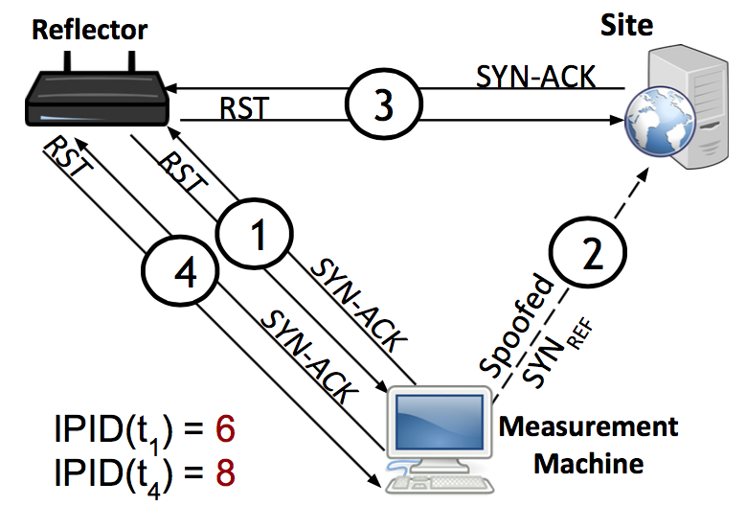
Key Observation: IP ID Increment
Global IP ID for reflector
Increments for each packet sent
We can perturb this counter from a remote location
Continually probe reflector for IP ID value
Spoof packets from the measurement machine
Appear to come from reflector
Behavior under “normal” reachability
Notes:
The strategy behind our method is to leverage the fact that when an Internet host generates and sends IP packets, each generated packet contains a 16-bit IP identifier (“IP ID”) value that is intended to assist endpoints in re-assembling fragmented IPv4 packets.

Slide 28



Augur Requirements
“User” (Reflector)
Must maintain a global value for IP ID
Site
Open port and retransmitting SYN-ACKs
Measurement Machine
Must be able to spoof packets
Notes:
For spooky scan, the user doesn't need to be end user so we adopt the word reflect from now on.
The reflector must maintain a single global counter to generate IPID values regardless of destination IPs. The value of this counter at anytime reflects how many packets it has generated.
These requirements are very easy to satisfy.

Slide 29

“Normal”: No Blocking
Probe [IP ID: 7003]
Augur
6
SYN/ACK
7
RST [IP ID: 7002]
No direction blocked
1
SYN/ACK
Reflector IP ID:
7000
7001
7002
7003
2
RST [IP ID: 7000]
Measurement machine
Reflector
3
SYN/ACK
Spoofed SYN [src: Reflector IP]
4
5
RST [IP ID: 7001]
Site

Slide 30
Inbound Blocked
Probe [IP ID: 7002]
5
SYN/ACK
6
RST [IP ID: 7001]
1
SYN/ACK
Reflector IP ID:
7000
7001
7002
2
RST [IP ID: 7000]
Measurement machine
Reflector
3
Spoofed SYN [src: ClientIP]
SYN/ACK
4
Site
Notes:
We can get a sample of IP ID.

Slide 31
Outbound Blocked
6
SYN/ACK
7
RST [IP ID: 7002]
1
SYN/ACK
Reflector IP ID:
7000
7001
7002
2
RST [IP ID: 7000]
Measurement machine
3
5
RST
Spoofed SYN [src: ClientIP]
SYN/ACK
4
Site
Notes:
We can get a sample of IP ID.

Slide 32
Outbound Blocked
Probe [IP ID: 7004]
6
SYN/ACK
7
RST [IP ID: 7002]
1
SYN/ACK
Reflector IP ID:
7000
7001
7002
7003 7004
2
RST [IP ID: 7000]
Measurement machine
3
5
RST
Spoofed SYN [src: ClientIP]
SYN/ACK
4
Site
Notes:
We can get a sample of IP ID.

Slide 33
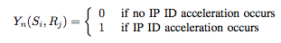
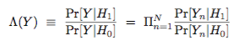
Statistical Detection: Max Likelihood
Random variable: IP ID acceleration
Detect the presence or absence of a prior (in this case, our perturbation), based on the separation of distributions of values under the prior.
Detection framework: Statistical Hypothesis Testing
Assumptions: IP ID acceleration is stationary, i.i.d.
Randomization of trail order, run trials over a course of weeks
Likelihood ratio:

Slide 34
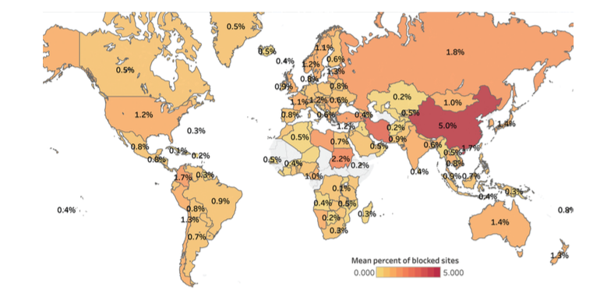
Pearce, Paul, et al. "Augur: Internet-Wide Detection of Connectivity Disruptions." Security and Privacy (SP), 2017 IEEE Symposium on. IEEE, 2017.
Notes:
Global heat map showing the percentage of sites filtered for any client in countries around the world. China experiences the highest average amount of filtering, at 5% of measurable sites filtered by a resolver within the country.

Slide 35
DNS Overview: Mapping Names to Addresses
www.cs.princeton.edu
root, .edu
www.cs.princeton.edu
NS dns.princeton.edu
NS dns1.cs.princeton.edu
dns.princeton.edu
Client
Local
DNS resolver
A 128.112.136.35
dns1.cs.princeton.edu
DNS is not secured! Possible for manipulation attacks to occur.

Slide 36
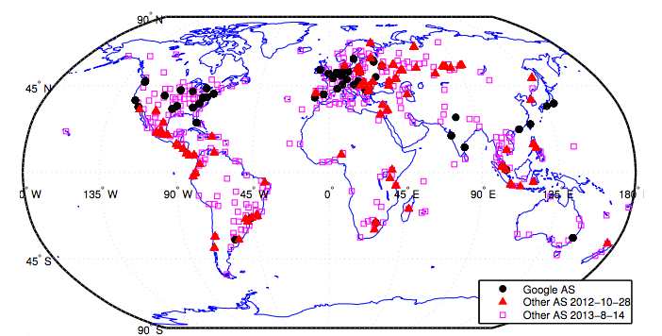
Detecting DNS Manipulation
Strawman: Find instances where the IP address returned does not agree with the “right answer”.
Problem: There is not a single right answer…
Extreme example: IP addresses returned for google.com (Katz-Bassett et al.)
Pearce, Paul, et al. "Global Measurement of DNS Manipulation." 26th {USENIX} Security Symposium ({USENIX} Security 17). USENIX} Association, 2017.

Slide 37
Consistency Metrics
IP Address
Autonomous System (“ISP”)
HTTP Content returned
Consistency of HTTPS certificate
Reverse DNS lookup (IP address to name)

Slide 38
Independently Verifiable Metrics
Content of HTTPS Certificate
Does the IP address present a correct domain in a valid, browser-trusted certificate
Same test, but with certificate fetched with SNI (the domain name)

Slide 39
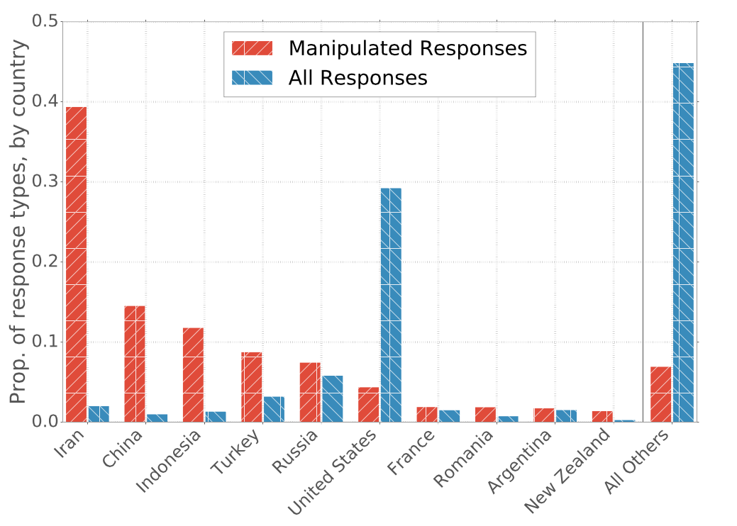
Prevalence of Manipulation by Country

Slide 40
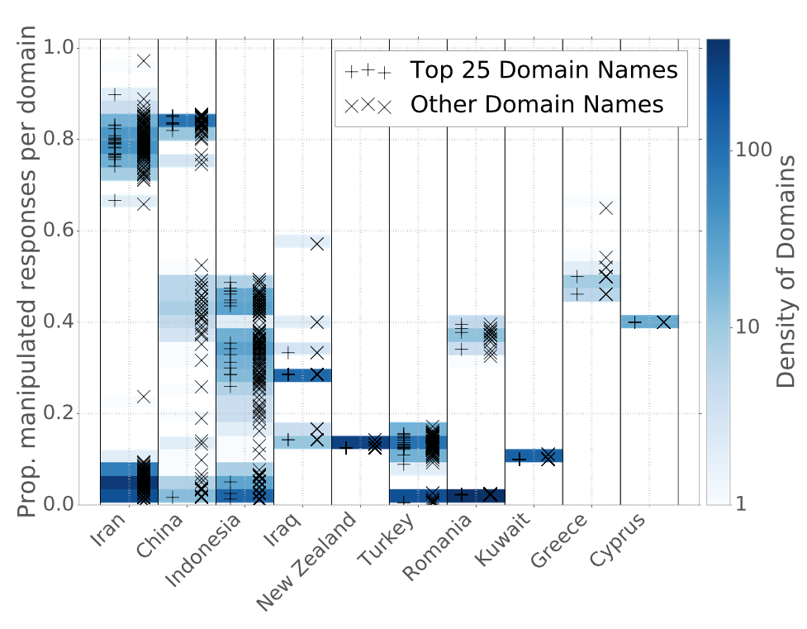
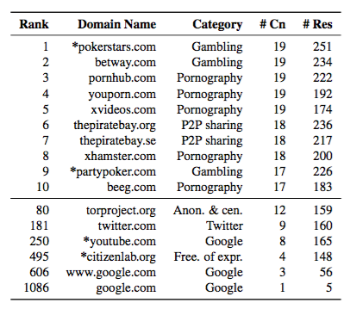
Manipulation of Domains within Countries
Notes:
----- Meeting Notes (4/14/17 13:50) -----
Need a version of this plot by category.

Slide 41
Control of Online Communication
Controlling Protocols Filtering and manipulation of Internet protocols
HTTP, TCP/IP, DNS
Circumvention tools (e.g., Tor)
Controlling Attention Filtering and manipulation on Internet platforms
Filter bubbles
Personalization (and attacks)
Automated filtering

Slide 42
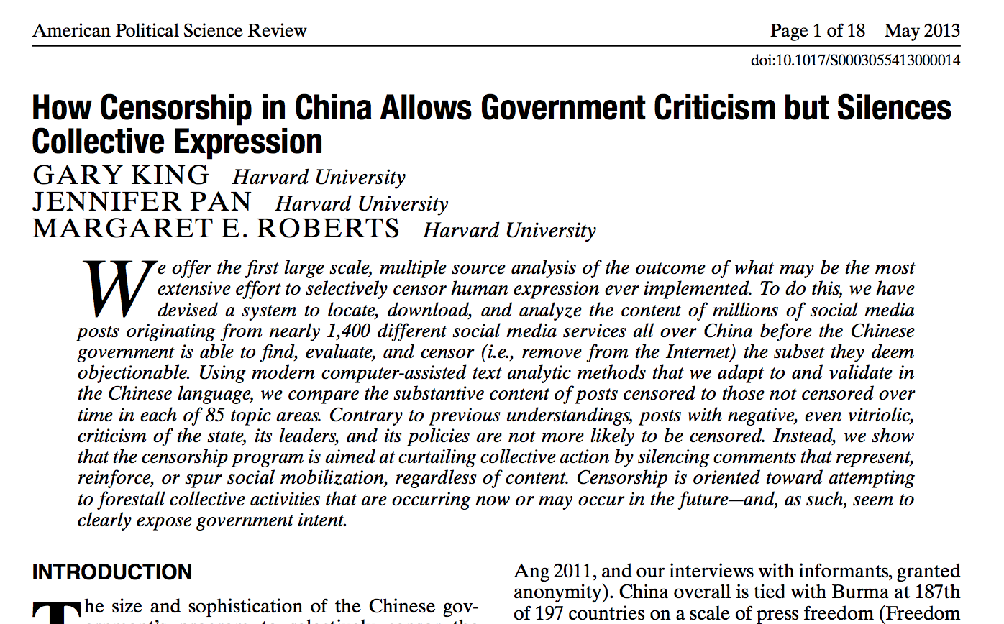
No need to filter speech if you can control the conversation.

Slide 43
Controlling Attention
Propaganda
Pollution
Automated Content Filtering

Slide 44
Controlling Attention (2012): Propaganda

Slide 45
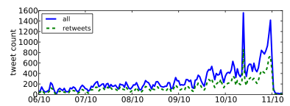
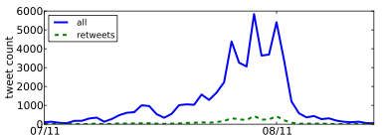
Detecting Propaganda
How can Twitter be used to affect public opinion?
Can we detect when Twitter is being used to spread propaganda?
Nevada Senate Race
Debt Ceiling Debate

Slide 46





Personalization as “Filter Bubble”
“A squirrel dying in front of your house may be more relevant to your interests right now than people dying in Africa”
– Mark Zuckerberg
Online personalization is creating situations where we only see things that already suit our own tastes.
Personalization can also be exploited.

Slide 47
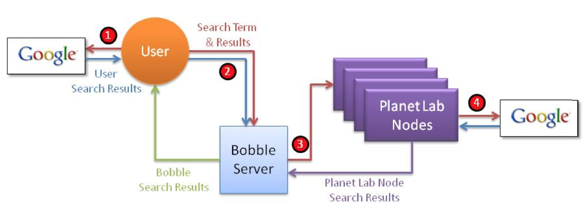
Bobble: Bursting the Filter Bubble
Execute query
As different users
Different vantage points
With different history (e.g., cookies)
Compare differences in results
What shows up on the first page?
Where does it show up?
When it doesn’t appear, what are the possible explanations?

Slide 48

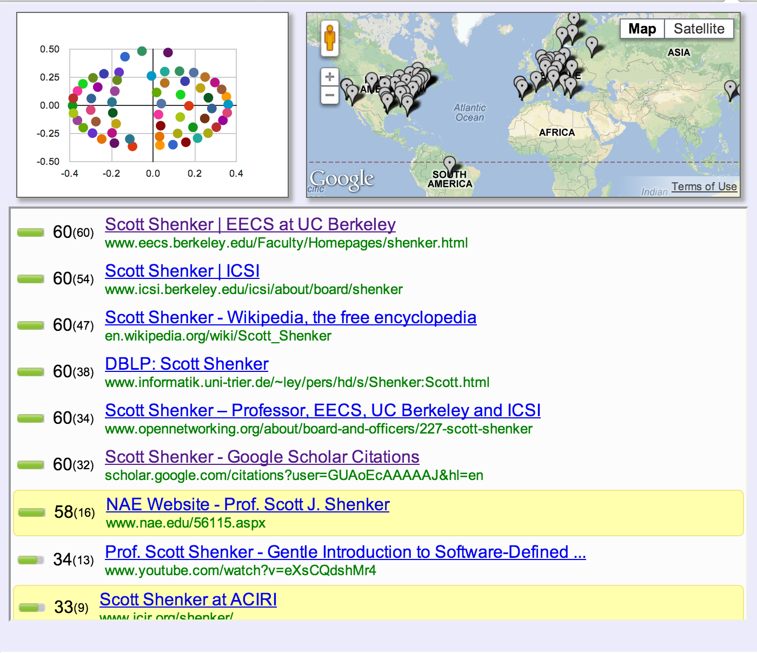
Things you didn’t see!
Xing, Xinyu, et al. "Exposing inconsistent web search results with bobble." International Conference on Passive and Active Network Measurement

Slide 49
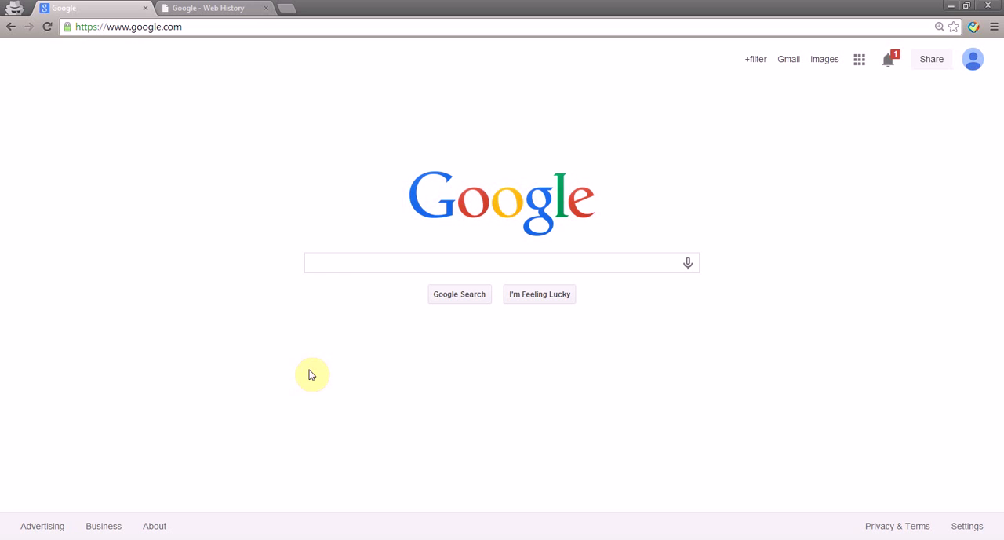
Pollution Attacks: Web Insecurity and Speech
Take This Personally: Pollution Attacks on Personalized Services. X. Xing, W. Ming, D. Doozan, A. Snoeren, N. Feamster, W. Lee. In USENIX Security Symposium, 2013.

Slide 50
Controlling Attention (2018): Automated Filtering

Slide 51
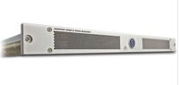
Filtering “Unwanted Traffic” (Spam)
Prevent unwanted traffic from reaching a user’s inbox by distinguishing spam from ham
Question: What features best differentiate spam from legitimate mail?
Content-based filtering: What is in the mail?
IP address of sender: Who is the sender?
Behavioral features: How the mail is sent?

Slide 52
Network-Level Features Can Identify Spam…

Slide 53
Automated Filtering of Spam (2009)
Network-level features to train RuleFit classifier
Comparable performance to manual blacklists
Using only network-level features
Completely automated
Hao, Shuang, et al. "Detecting Spammers with SNARE: Spatio-temporal Network-level Automatic Reputation Engine." USENIX security symposium. Vol. 9. 2009.

Slide 54
…once you get the automated filters to only filter out the “bad stuff”, it’s all good, right?

Slide 55
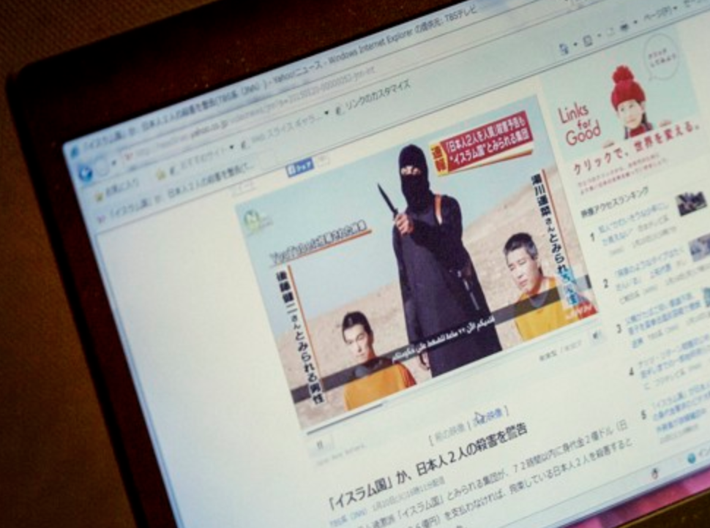
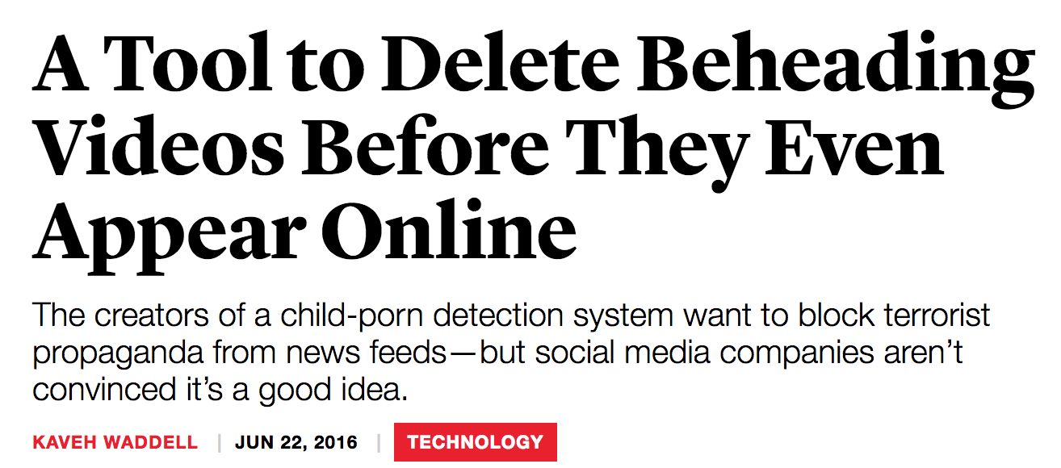
Automated Filtering and Speech

Slide 56
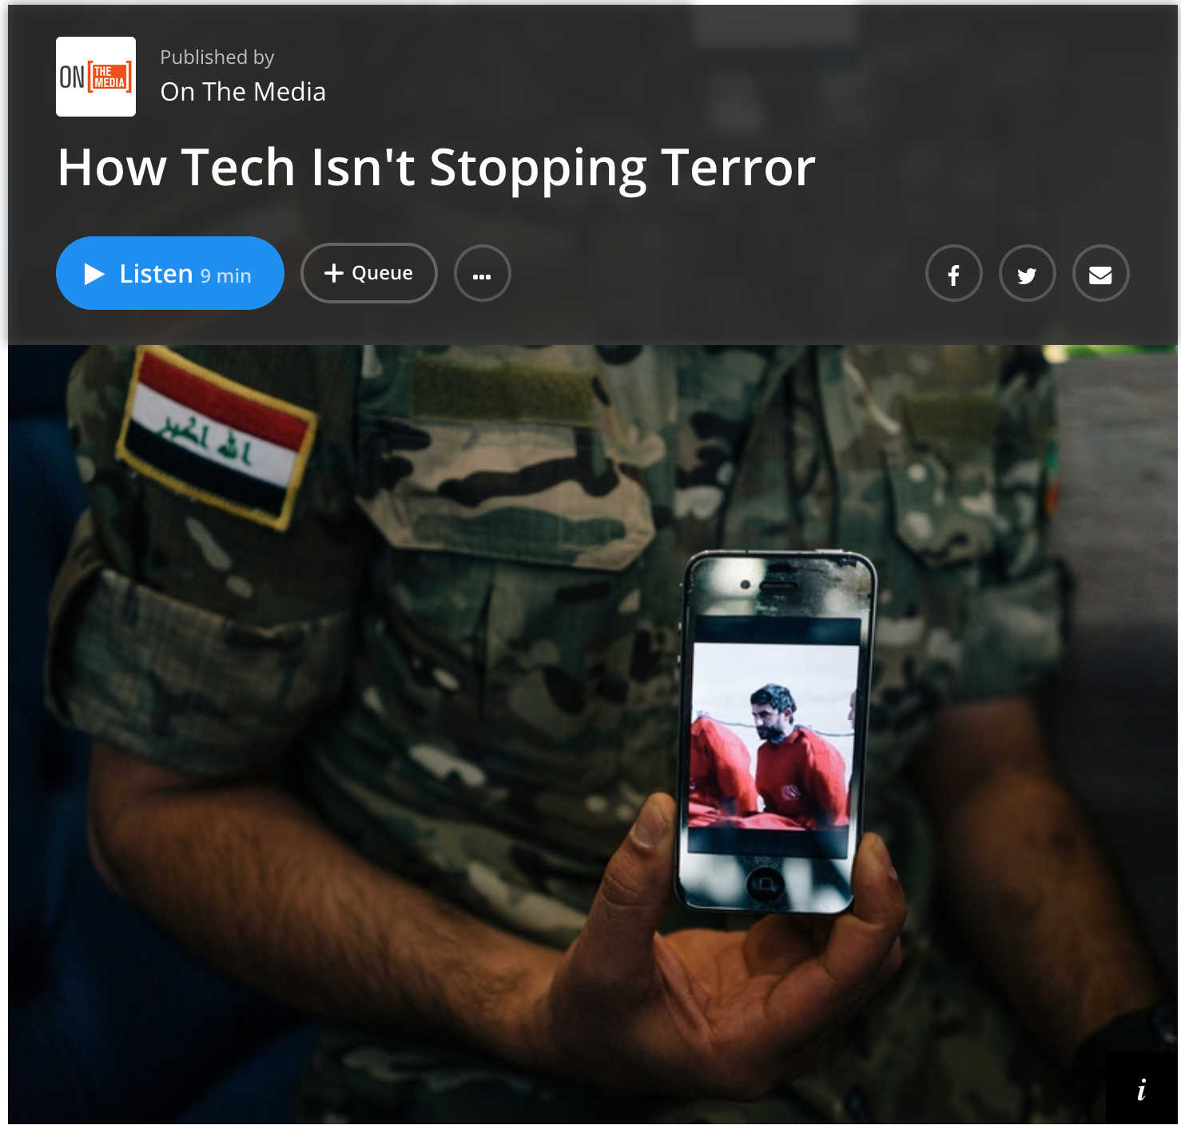

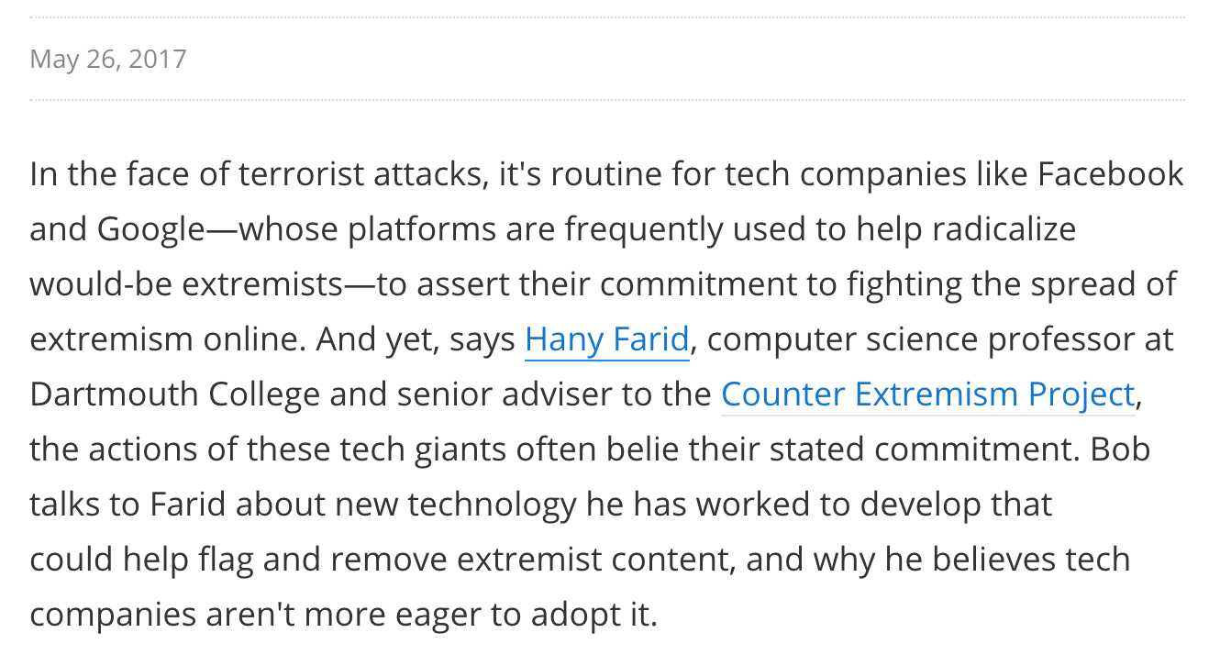

Slide 57
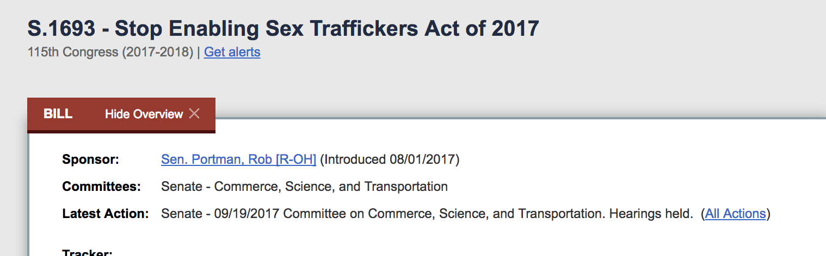
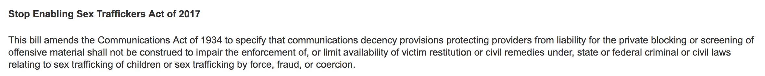
Most of tech industry opposes. Supporters include: Oracle, Motion Picture Association of America, …

Slide 58
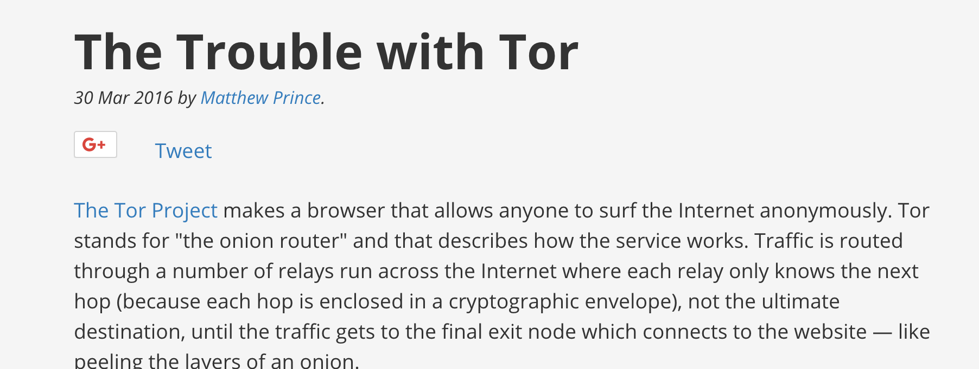
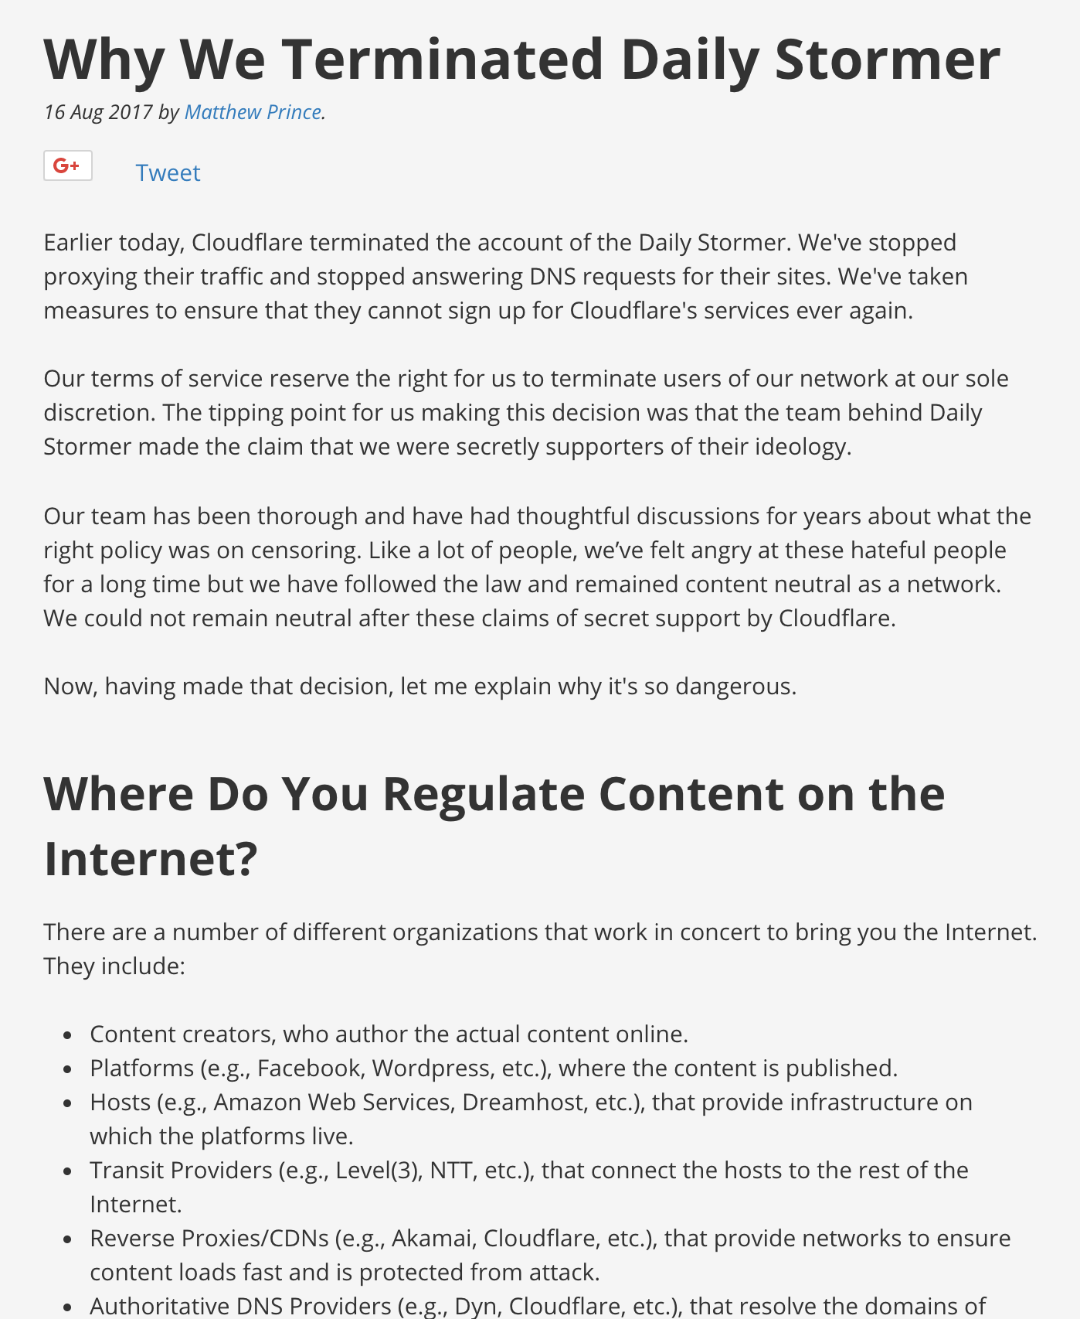

Slide 59
General problem is much harder than spam, phishing, child porn…
Context
Fair use
Parody
…

